Slide 1
Problem Statement
Cryptography Simulation with
mbedTLS/OpenSSL Library
Cryptography simulation involving implementing secure cryptographic algorithms, key management, and testing within a chosen programming environment with mbedTLS/OpenSSL Library.

Slide 2
Unique Idea Brief (Solution)
Developing a secure file encryption application with integrated cloud storage support which provides:
Data Privacy: Ensures user data remains encrypted both at rest and in transit, safeguarding against unauthorized access and data breaches.
Convenience: Provides seamless integration with cloud storage, allowing users to securely store and share encrypted files across devices and platforms.
Security Compliance: Adheres to industry-standard encryption practices and data protection regulations to maintain user trust and compliance.

Slide 3
Features Offered
HMAC-SHA256 Generation: Generates HMAC-SHA256 for message authentication, ensuring data integrity and authenticity.
Key Derivation using HKDF-SHA256: Derives cryptographic keys securely using HMAC-based Key Derivation Function (HKDF) with SHA-256, enhancing key management practices.
AES-GCM256 Encryption and Decryption: Encrypts and decrypts data using Advanced Encryption Standard (AES).
RSA-PSS Digital Signature Operations: Signs and verifies messages using RSA-PSS (Probabilistic Signature Scheme), providing non-repudiation and integrity verification.

Slide 4
Diffie-Hellman Key Exchange Simulation: Simulates Diffie-Hellman key exchange to securely establish shared secrets between parties, facilitating secure communication.
Certificate Handling: Reads RSA private keys from files and validates certificates, essential for secure authentication and establishing trust in communication.
Utility Functions: Provides utility functions for random data generation, secure memory management, file I/O operations, and secure cleaning of memory buffers, ensuring robust security practices.
Testing and Validation: Includes test functions like HMAC verification tests, ensuring correctness and reliability of implemented cryptographic operations.

Slide 5
Process flow
The cryptography simulation begins with the initialization of cryptographic keys, starting with the generation of an initial secret key and a salt for subsequent key derivation using HKDF-SHA256. This process ensures that keys used for encryption, HMAC-SHA256 authentication, and other cryptographic operations are derived securely from a strong initial secret.
Once keys are derived, the simulation enables HMAC-SHA256 generation to authenticate message integrity. For encryption, AES-GCM256 is employed with a randomly generated initialization vector (IV) to encrypt plaintext data, appending an authentication tag for integrity verification during decryption.

Slide 6
It also supports RSA-PSS digital signature operations, allowing messages to be signed with a private key and verified with a corresponding public key. Additionally, it simulates the Diffie-Hellman key exchange protocol for secure key establishment between parties. Certificate handling functionalities include reading RSA keys from PEM files and validating X.509 certificates for secure communication.
Utility functions ensure secure data management and include random data generation, file I/O operations, and memory buffer cleaning to maintain robust security practices throughout the cryptography simulation.

Slide 7
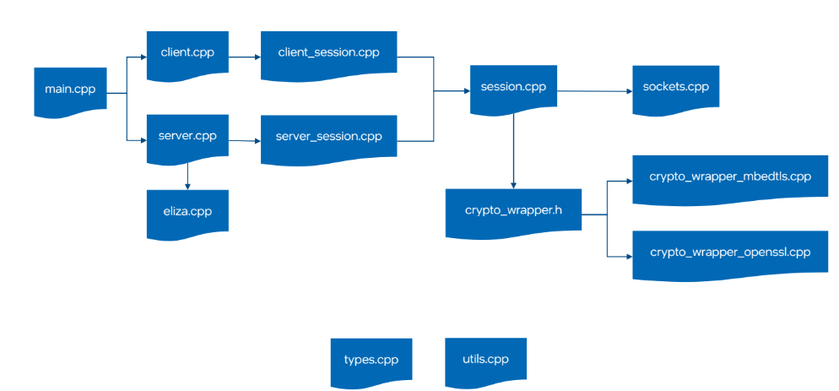
Architecture Diagram
Code Architecture

Slide 8
Technologies used
HMAC-SHA256 for message authentication, AES-GCM256 encryption for data confidentiality, and RSA-PSS for digital signatures. Additionally, OpenSSL is used for key derivation with HKDF-SHA256, Diffie-Hellman key exchange simulation, and handling RSA keys and X.509 certificates for secure communication. Utility functions ensure secure data handling, including random data generation and memory management.

Slide 9
Team members and contribution:
As the sole member of the cryptography simulation, I've taken on all responsibilities from starting till implementation using OpenSSL. This includes coding functionalities such as HMAC-SHA256 for message integrity, AES-GCM256 for encryption, and RSA-PSS for digital signatures. I've also implemented key derivation using HKDF-SHA256, simulated Diffie-Hellman key exchange, and handled RSA keys and X.509 certificates for secure communication.

Slide 10
Conclusion
In summary, the cryptography simulation using OpenSSL showcases a thorough application of OpenSSL's capabilities to implement advanced cryptographic techniques. It highlights the focus on ensuring data integrity, confidentiality, and authentication through features like HMAC-SHA256 for message integrity, AES-GCM256 encryption for secure data transmission, and RSA-PSS for digital signatures. It also includes key derivation using HKDF-SHA256, simulation of Diffie-Hellman key exchange for secure key establishment, and handling of RSA keys and certificates for secure communication. Overall, the project exemplifies robust implementation of cryptographic standards and practices to achieve secure software solutions.

